Slide 1
Global Agricultural Production and Population Analysis
Project 1
Corey Holton, Elena Gehle, Domenic Guerrero, and Roberta Chandler

Slide 2
Overview
Introduction
Background: This project analyzes global agricultural production relative to population data over time. It uses Python to process data on agricultural production by category, and country, as well as global and continental population data. The goal is to visualize trends and relationships between food production and population growth.
Purpose: Explain the significance of understanding the relationship between agricultural production and population.
Objective: To analyze how global agricultural production has changed relative to population over time, focusing on key agricultural products.
2. Research Questions
Key Questions:
How has the production of major agricultural products (e.g., meat, vegetables, grains) evolved over time?
How does agricultural production vary across different countries and continents?
What trends can be observed in the relationship between agricultural production and population growth?

Slide 3
Data collection, cleanup, and exploration
Following the selection of an area of focus, an extensive search was conducted to identify suitable datasets for agricultural production and global population data. Upon acquiring the datasets, they were imported into a notebook for initial examination. It was quickly identified that the agricultural data contained an excess of information, while the population data lacked complete yearly records. To address this gap, an additional population dataset was obtained and merged with the initial set to ensure alignment of time frames.
The datasets were then refined by removing non-essential columns and restructuring the data to fit the analysis objectives. To streamline the visualization process, data was aggregated at the continental level, given the large number of countries involved. Agricultural items were categorized according to predefined classifications. The final dataset was transformed into a time series format, facilitating statistical analysis and the creation of visual plots to illustrate trends.

Slide 4
Exploration of data
1. Aggregation
Production by Category and Continent: Aggregated production data at different granularities, such as yearly totals by category and continent. Explored averages, maximum, minimum, and sum statistics for different categories.
Top 5 Items by Country: Aggregate the data to identify the top-producing items for a given country (China example in slides).
2. Correlation Analysis
Production vs. Population Growth: Analyzed how the production of food changes with population growth. Used correlation coefficients (Pearson, Spearman) to assess the strength of these relationships.
Category Comparisons: Investigated correlations between different production categories within the same continent, e.g., if meat production increases with grain production.
3. Comparison Analysis
Continent Comparisons: Compare production trends across continents to see which continents have experienced the most growth or decline in specific agricultural categories.
Category Comparisons within Countries: Compared how different agricultural categories contribute to a country’s total production and how these have changed over time.
4. Summary Statistics
Yearly Production Summaries: Calculate mean, median, standard deviation, and quartiles for production data by category, to identify trends and anomalies.
5. Sentiment Analysis
Public Perception of Agriculture: We could see a fall in Europe’s agricultural production which makes since given the negative perception farmers impose to the environment in Europe have received over the past decade.
6. Time Series Analysis
Forecasting Production Trends: Utilize time series analysis with Prophet to forecast future production levels for specific categories, continents, or countries (if we have time)
Population vs. Production Over Time: Time series was plotted to show population vs agricultural production on a global scale to see how the trends interact over time. This data could be used to predict the future of both population growth and agricultural supply for the future, although it does lack the availability of predicting yields and available farmland.

Slide 5
Approach to Achieving Project Goals
The project approach emphasized staying on task, maintaining diligence, and making consistent daily progress until all tasks were completed. Tasks were clearly outlined in detail, providing a structured roadmap for the work ahead.
To address the research questions, data preparation was the initial focus, ensuring the datasets were suitable for analysis. With the prepared datasets, various graphs were generated based on the questions posed. Observations from these visualizations sparked further data exploration, leading to deeper insights.
Subsequently, efforts were directed towards assembling the README file, which was completed efficiently. The final step involved creating an outline for the presentation and incorporating key graphs to guide the delivery of this segment, ensuring a comprehensive and cohesive presentation.

Slide 6
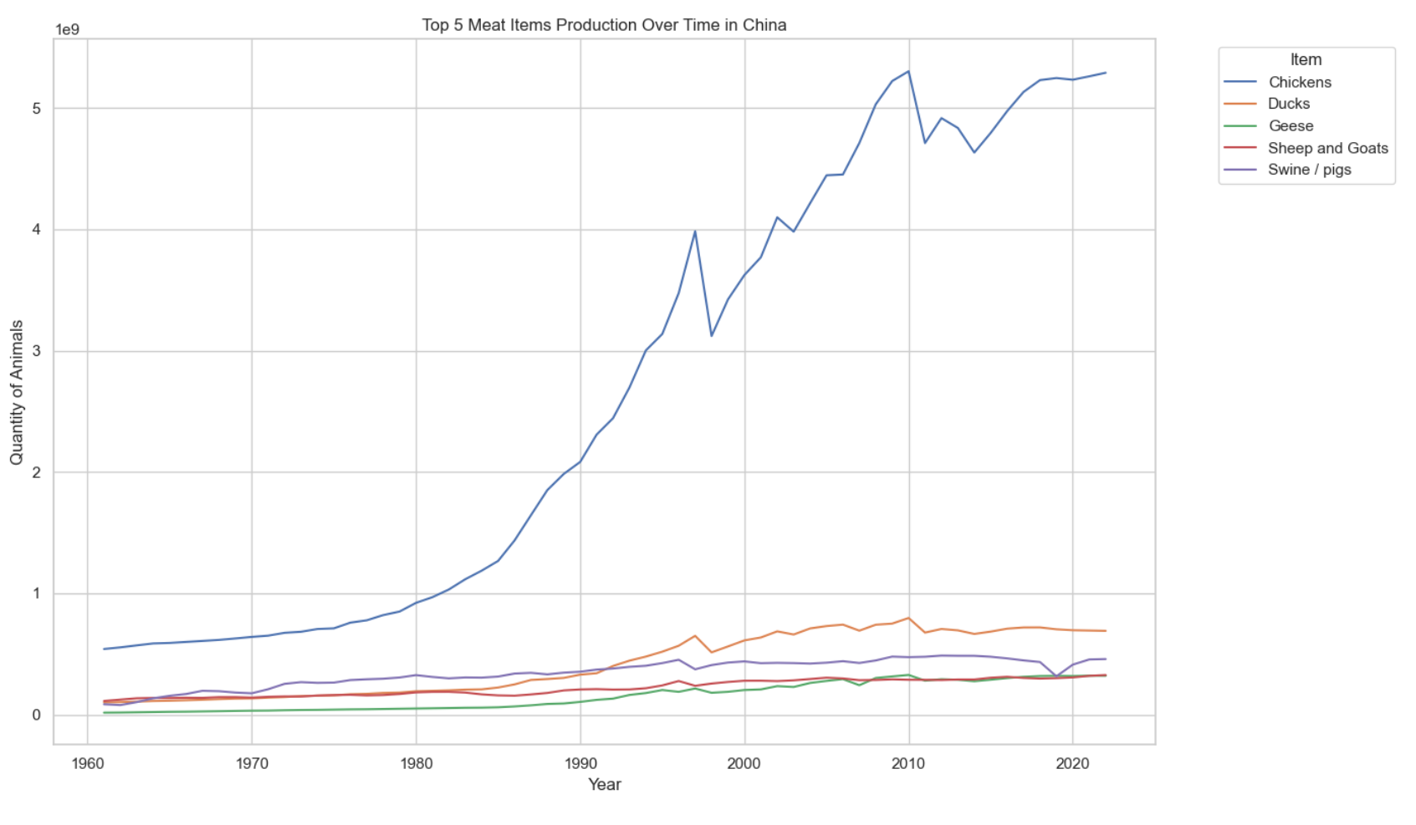
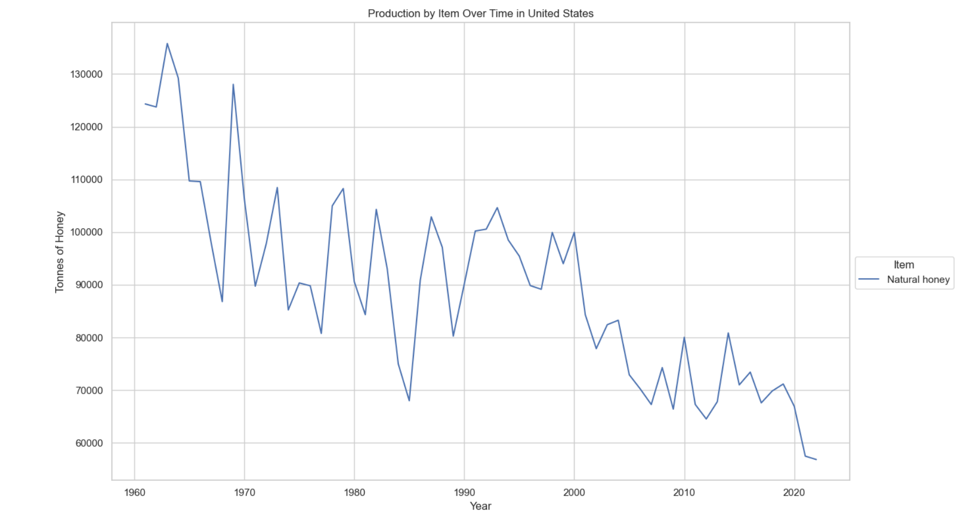
Additional Questions
Upon reviewing the data, several unexpected observations were made. First, North America emerged as a relatively small producer compared to other continents. A decline in food production was noted in Europe, raising questions about the underlying causes. An intriguing finding was that chickens are the most produced animal in nearly every country analyzed. Additionally, the U.S. exhibited a significant decline in honey production, which may be linked to the increased use of processed sugars—a trend that appears unique to the U.S. based on preliminary manual observations. These findings prompt further investigation into whether this pattern is a global phenomenon or confined to specific regions.

Slide 7
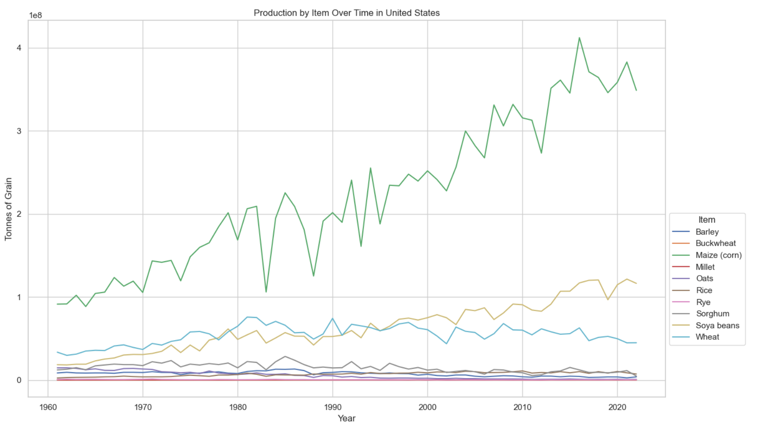
Plan for Future Development
Future development could focus on deeper analysis of honey production trends by country to determine if the observed decline is isolated to the U.S. or part of a broader global trend. Further exploration into the factors influencing corn production dips in the U.S. could also be prioritized, potentially examining climate data, such as drought occurrences. Expanding the data scope to include additional variables and investing in more time and resources for comprehensive analysis would be critical to uncovering the causes behind these observations.

Slide 8
Analysis and Conclusion
Findings are strongly supported with numbers and visualizations (10 points).
Write-up summarizes major findings and implications at a professional level (10 points).
Each question in the project proposal is answered with precise descriptions and findings (5 points).
Each question response is supported with a well-discerned statistical analysis from lessons, such as aggregation, correlation, comparison, summary statistics, sentiment analysis, and time series analysis (5 points).

Slide 9
Visualizations
6–8 visualizations of data (at least two per question) (10 points).
Clear and accurate labeling of images (5 points).
Visualizations supported with ample and precise explanation (5 points).

Slide 10
Presentation Requirements
Your presentation should cover the following:
An executive summary or overview of the project and project goals (5 points).
An overview of the data collection, cleanup, and exploration processes (5 points).
The approach that your group took in achieving the project goals (5 points).
Any additional questions that surfaced, what your group might research next if more time was available or share a plan for future development (5 points).
The results and conclusions of the application or analysis (5 points).
Slides effectively demonstrate the project (3 points).
Slides are visually clean and professional (2 points).

Slide 11
1. How has the production of major agricultural products (e.g., meat, vegetables, grains) evolved over time?
Data was initially reviewed by country, then aggregated to continent, and again aggregated to global to answer this question. Results vary by country most likely due to climate and soil fertility, but in general they have risen to meet the demand of the ever-growing population, except for many countries within Europe. Data shows that meat production increased the most followed by egg production then grain production, while other categories grew little in comparison. After observing the global production of each category food, it was natural to observe the subset of data under each category. Since meat had such high values, it was determined that this should be observed more granularly. After plotting each type of animal produced it was found that Chicken production has dwarfed all other meat production increasing almost exponentially while other animals grew minimally with the exception of sheep and goats that grew slightly

Slide 12
How has the production of major agricultural products (e.g., meat, vegetables, grains) evolved over time?
Technology
Plant varieties
Planting
Practice
Risk Management
Data Management
https://www.usda.gov
https://www.farmprogress.com
https://www.brunel.net

Slide 13
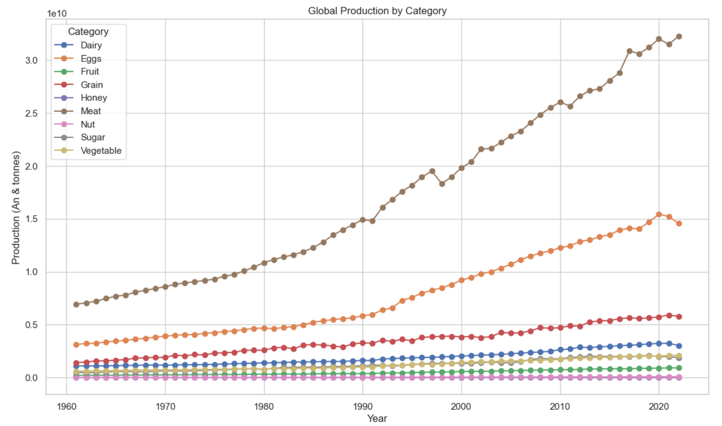
Graph of Global Production by Category

Slide 14
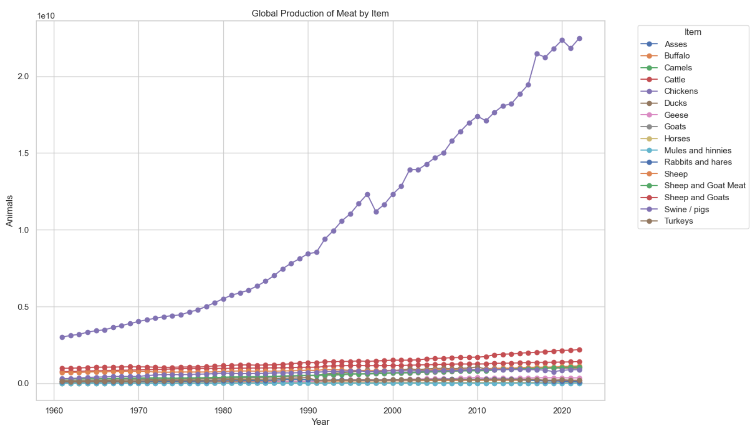
Graph of Global Meat Production by Item

Slide 15
2. How does agricultural production vary across different countries and continents?
Domenic Will ANswer this one
Geography
Politics and Economics
https://www.nature.com
https://voxdev.org
https://agclassroom.org

Slide 16
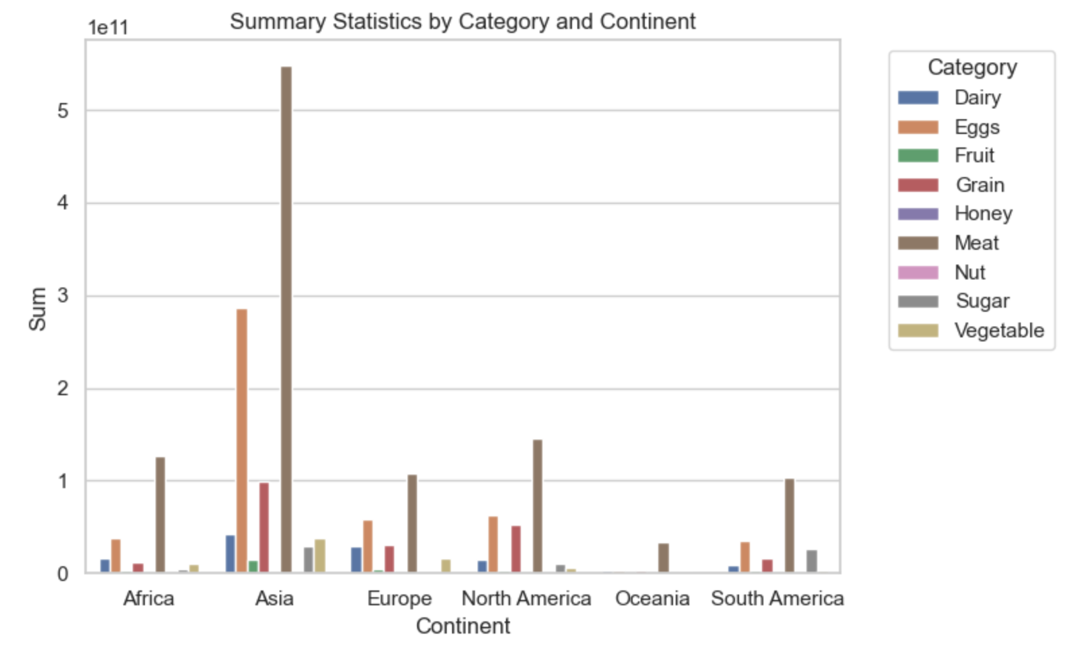
Production of category by continent (sum)

Slide 17
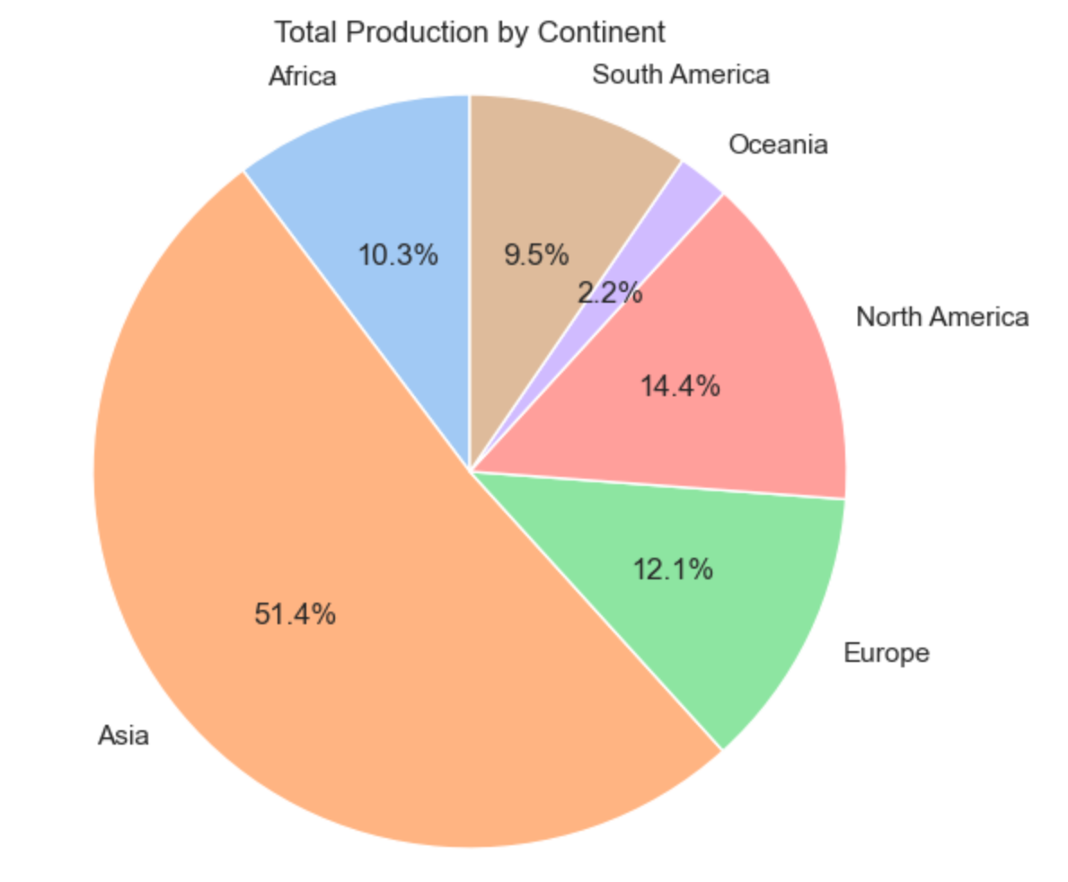
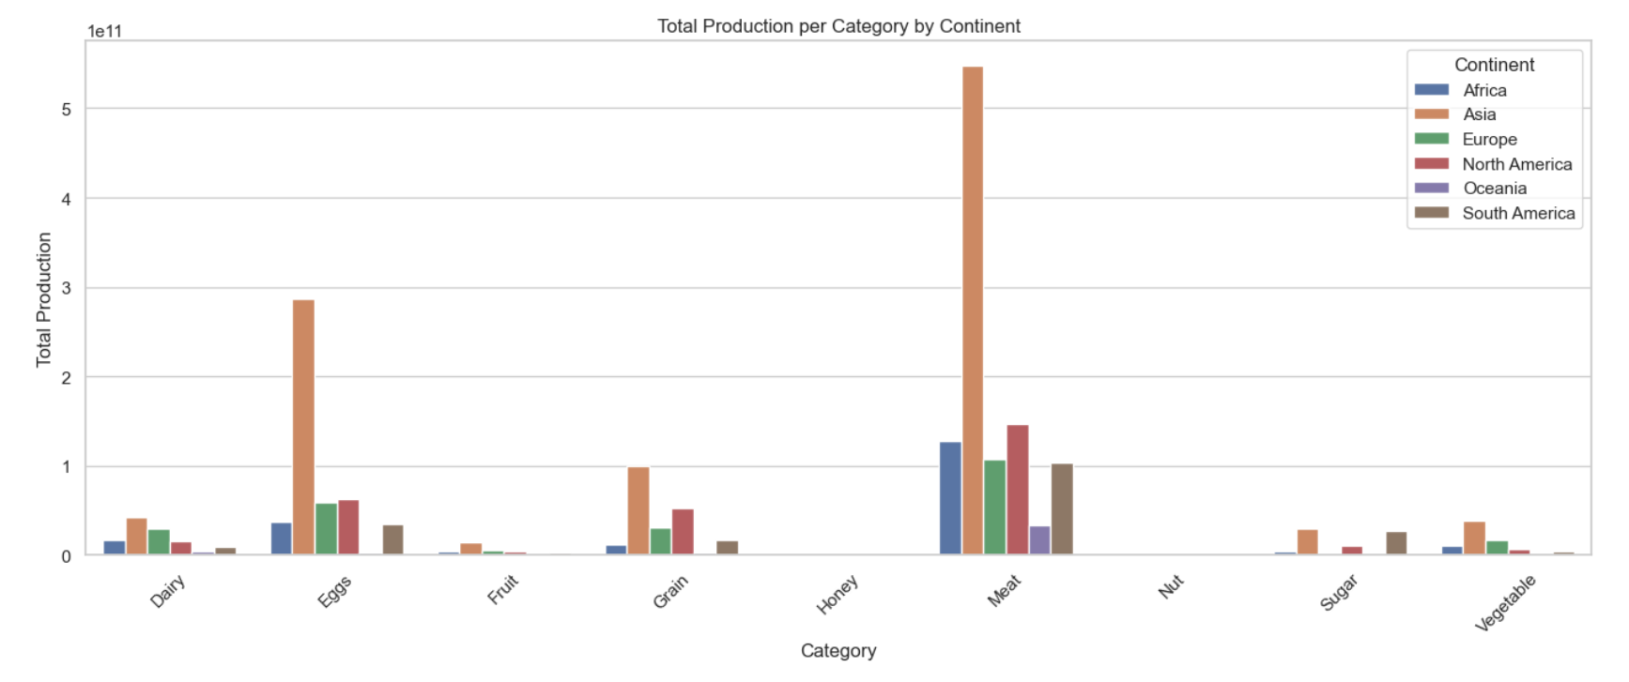
Sum of sums
sum

Slide 18
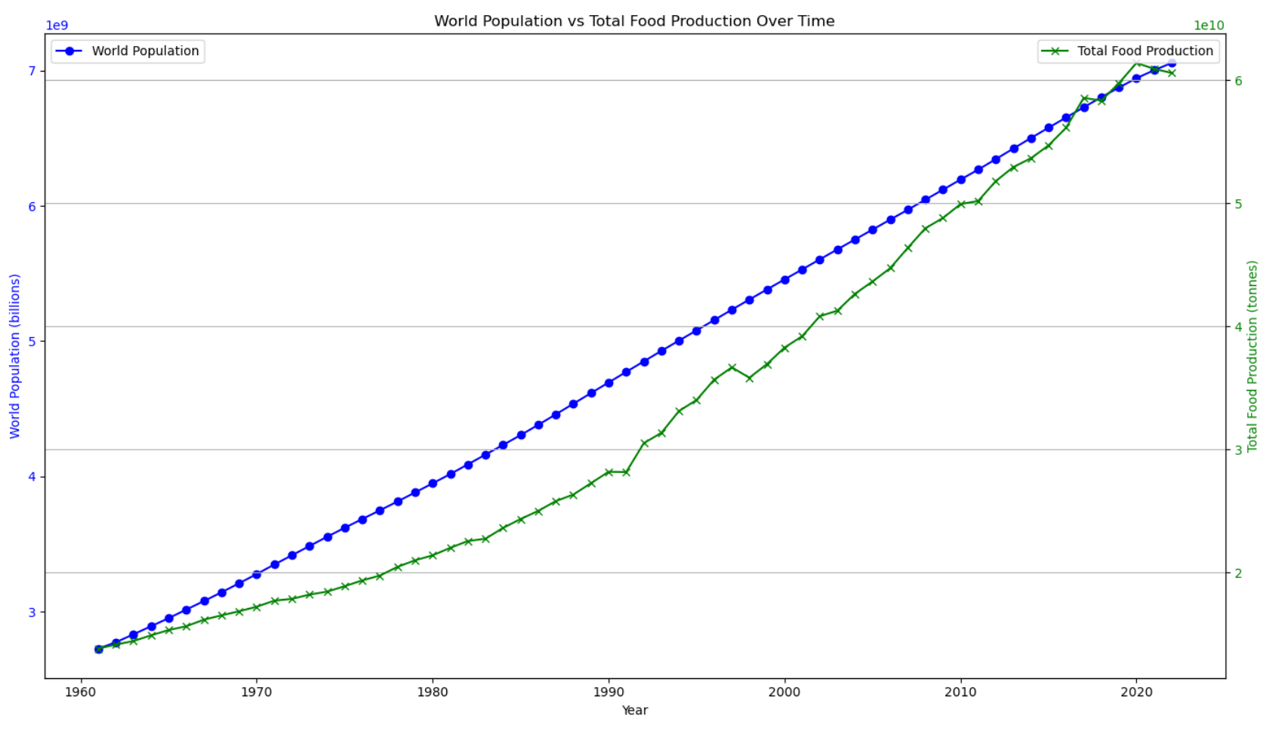
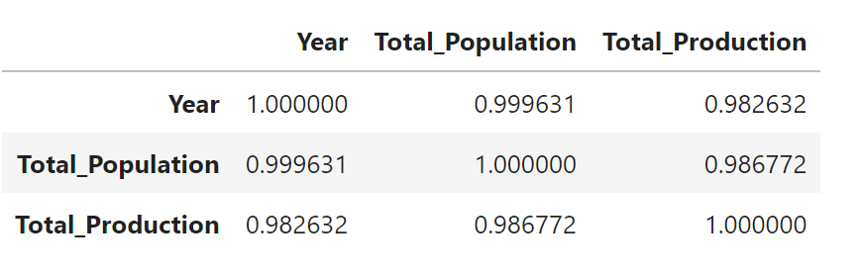
3. What trends can be observed in the relationship between agricultural production and population growth?
Upon reviewing the data a strong linear relationship was observed in the data between agricultural production and population growth. Population growth from the 1960’s till current has been at almost a constant growth, this is a bias in our dataset as world population pre-1960 was much flatter and future predictions expect population growth to decline. Agricultural production started in the 1960’s with an almost 1:1 with population but lagged until 2017 when it surpassed population then abruptly declined to pace with population demands as observed on the graph.
Pearson correlation coefficient: 0.9867722599767363
Spearman correlation coefficient: 0.9996474528468182

Slide 19
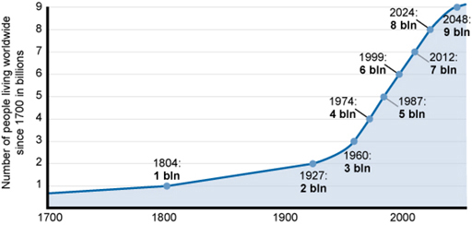
World Population vs Total Food Production

Slide 20
Conclusion
Findings are strongly supported with numbers and visualizations (10 points).
Write-up summarizes major findings and implications at a professional level (10 points).
Each question in the project proposal is answered with precise descriptions and findings (5 points).
Each question response is supported with a well-discerned statistical analysis from lessons, such as aggregation, correlation, comparison, summary statistics, sentiment analysis, and time series analysis (5 points).

Slide 21
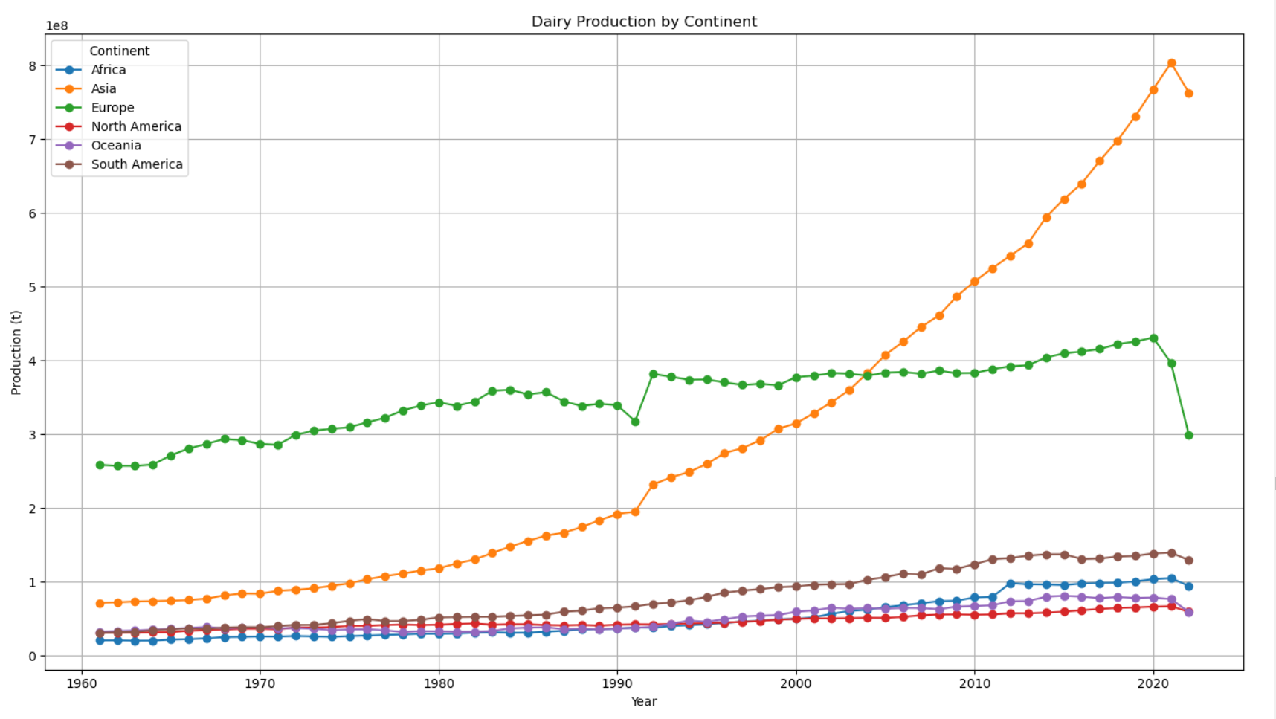
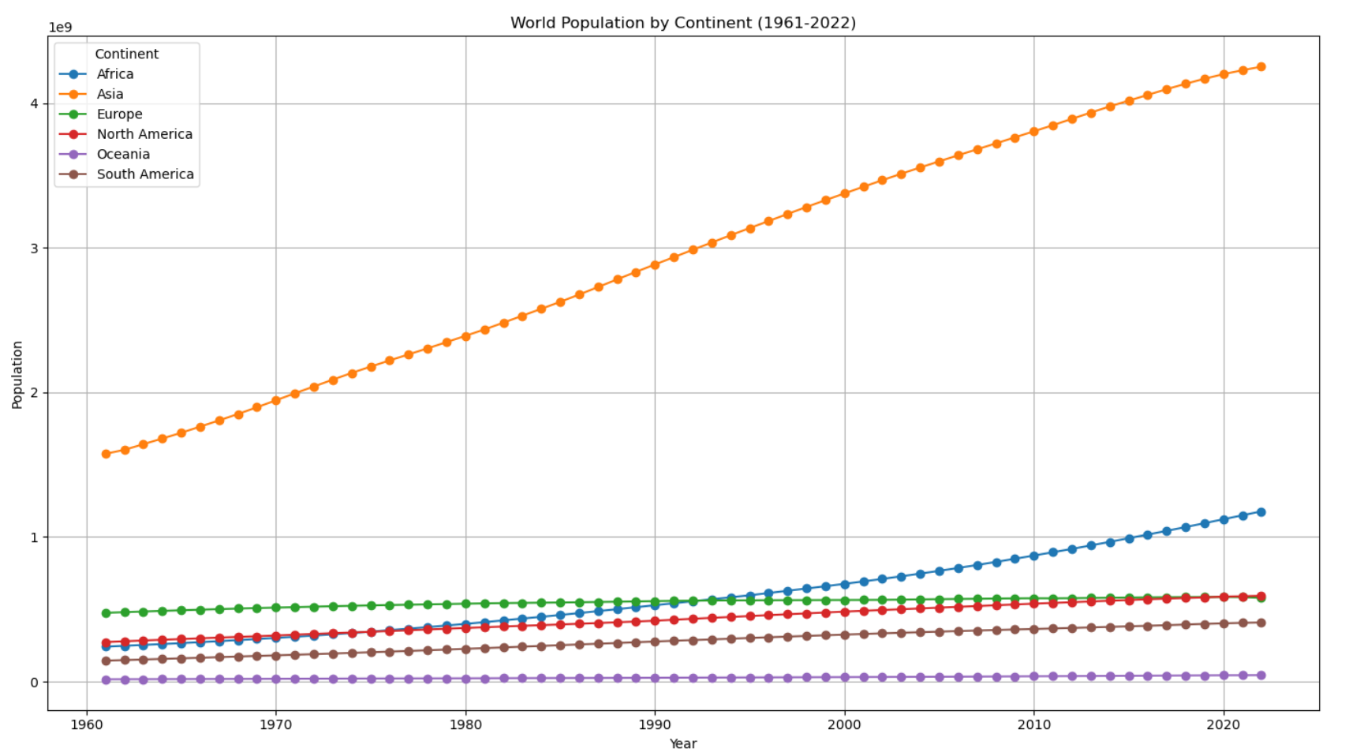

Slide 22
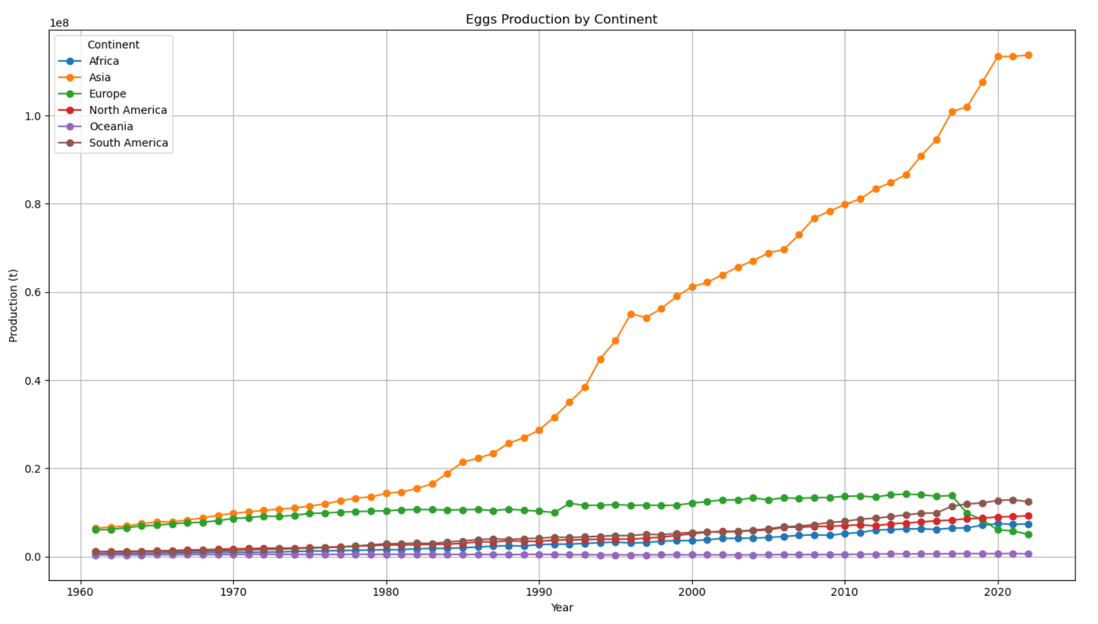

Slide 23
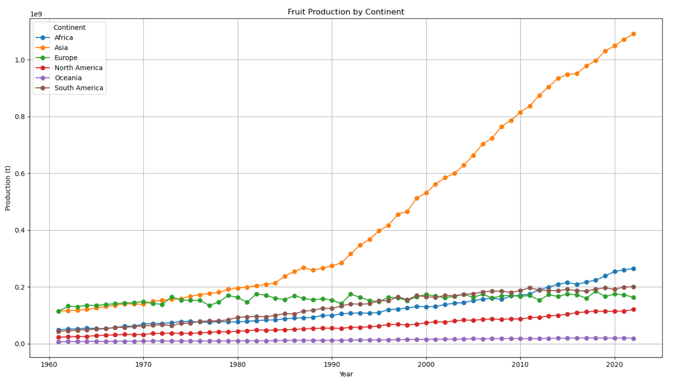

Slide 24
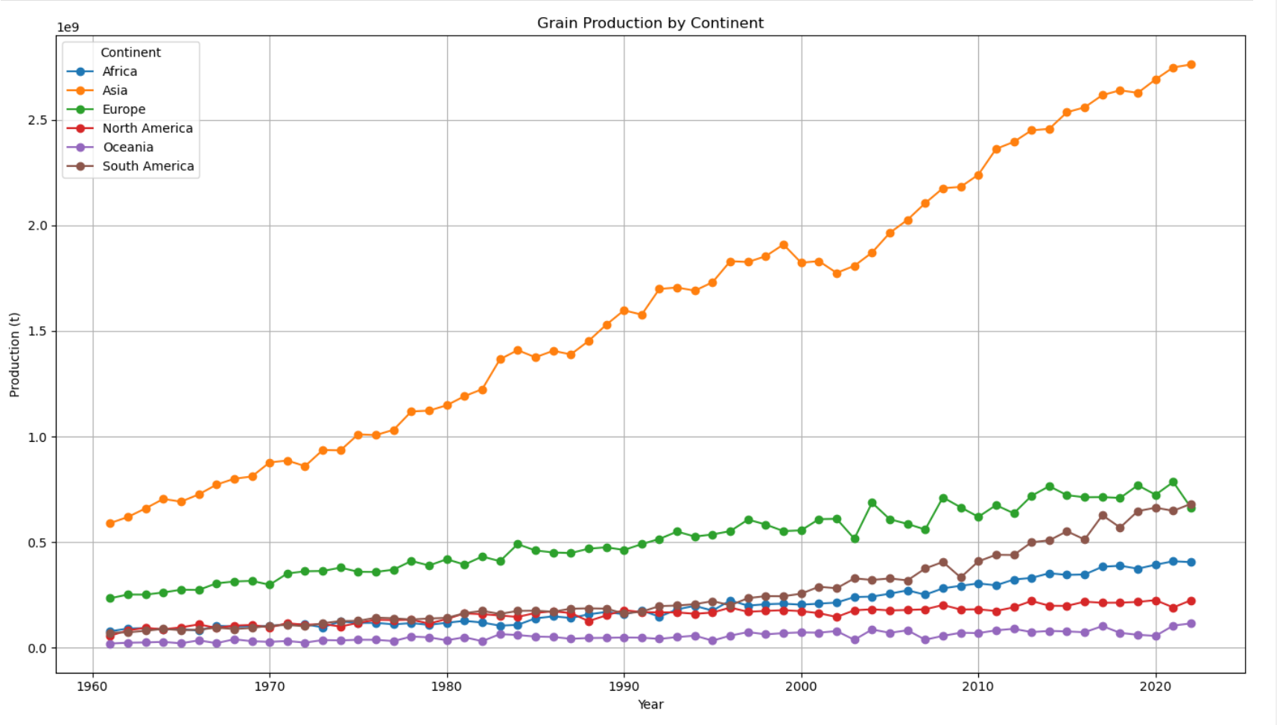

Slide 25
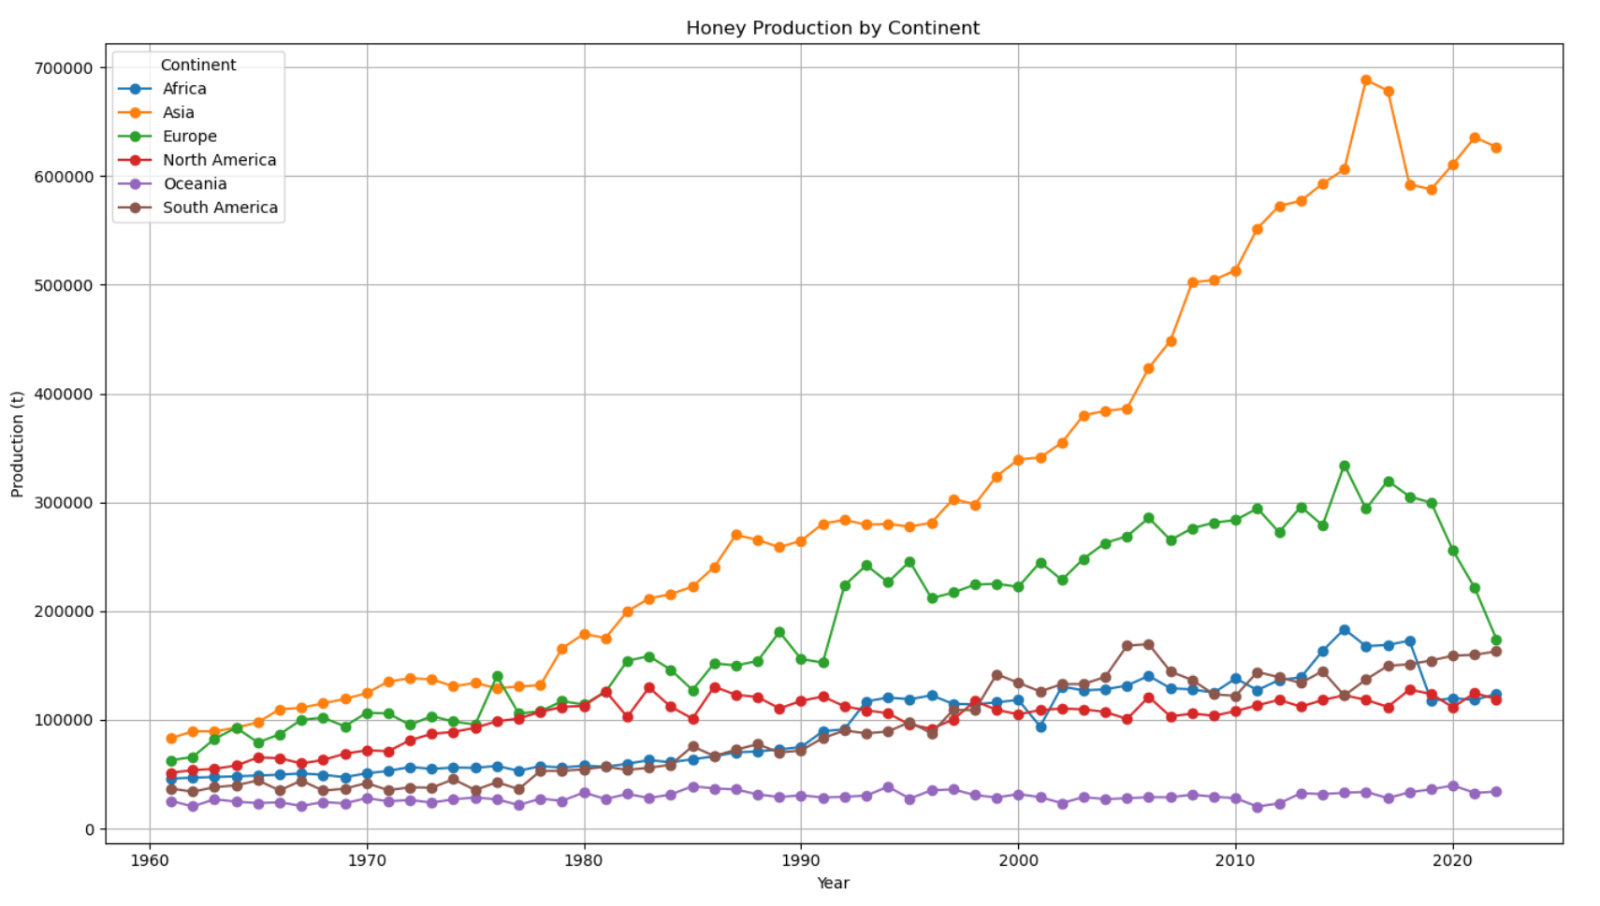

Slide 26
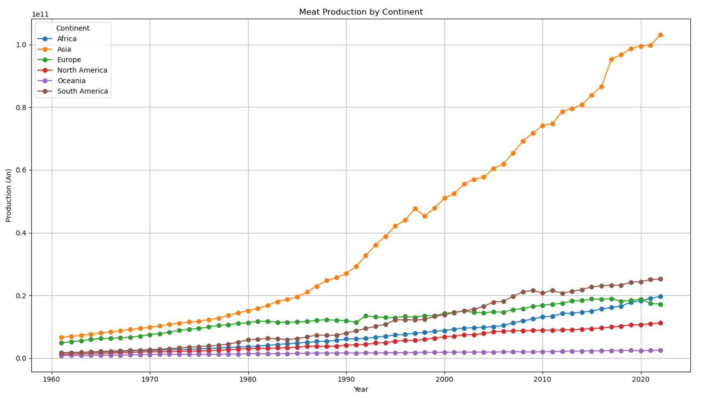

Slide 27
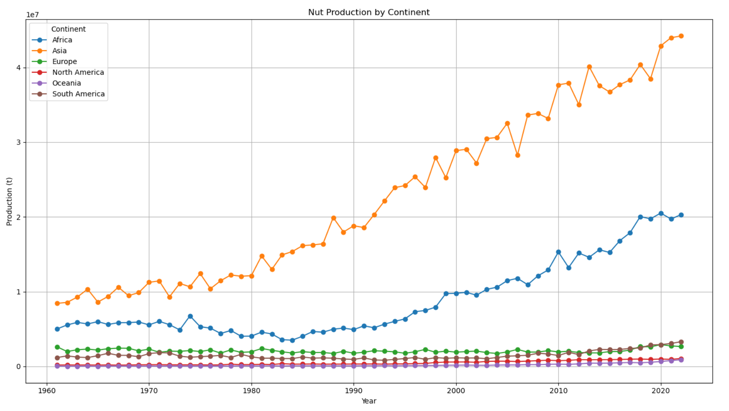

Slide 28
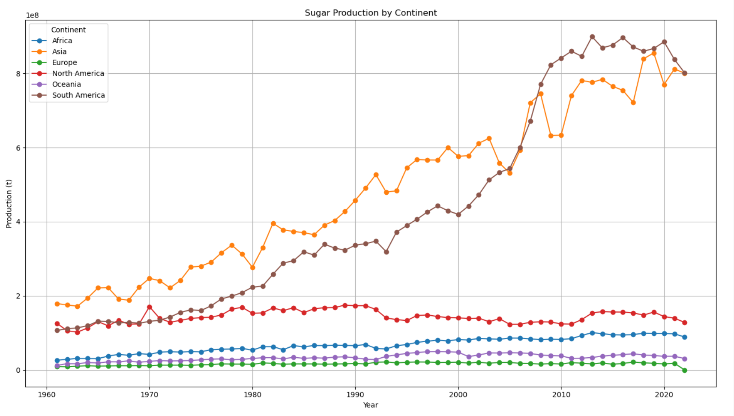

Slide 29
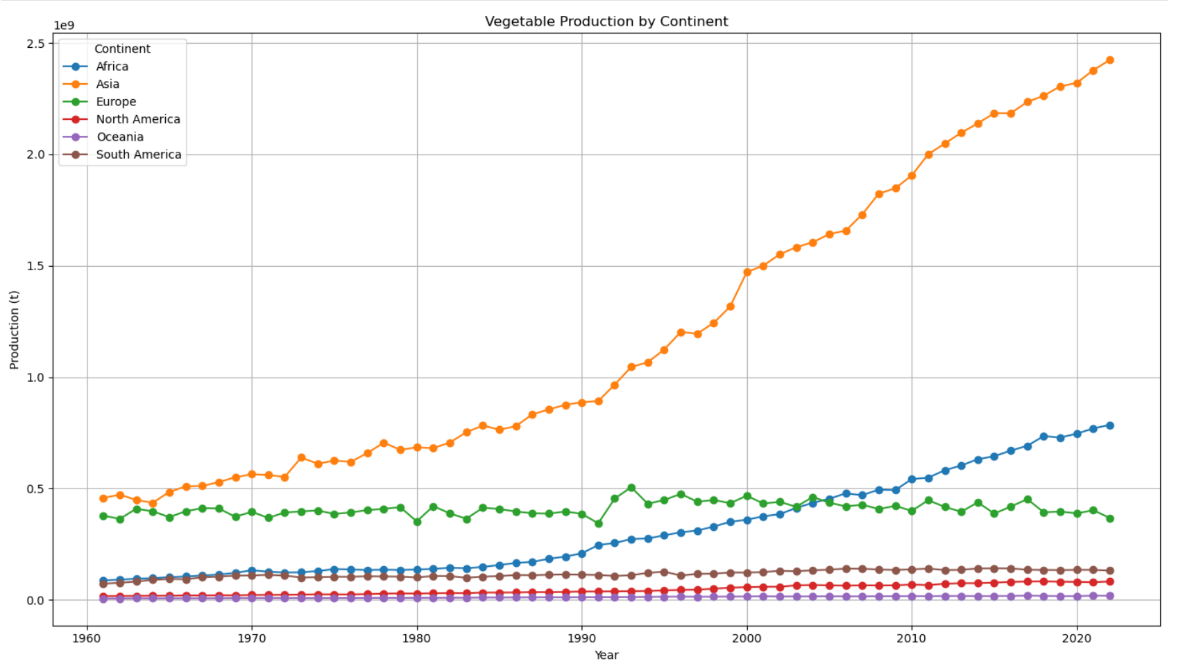

Slide 30
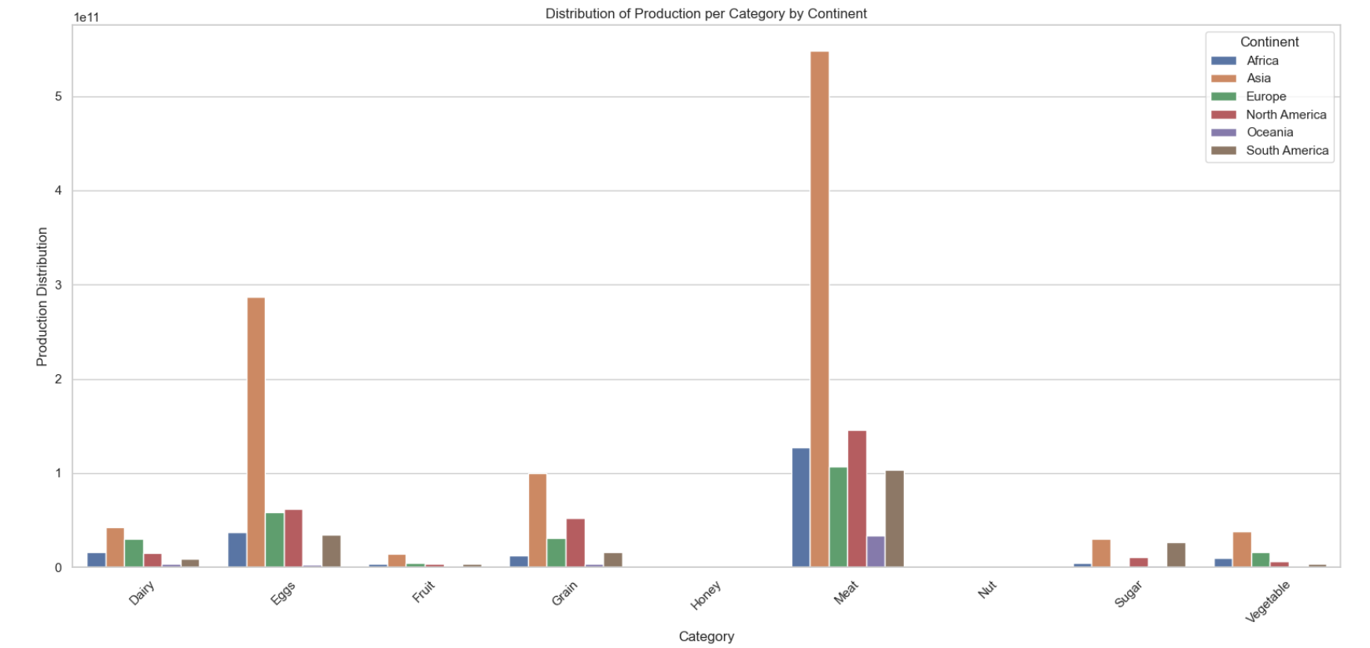
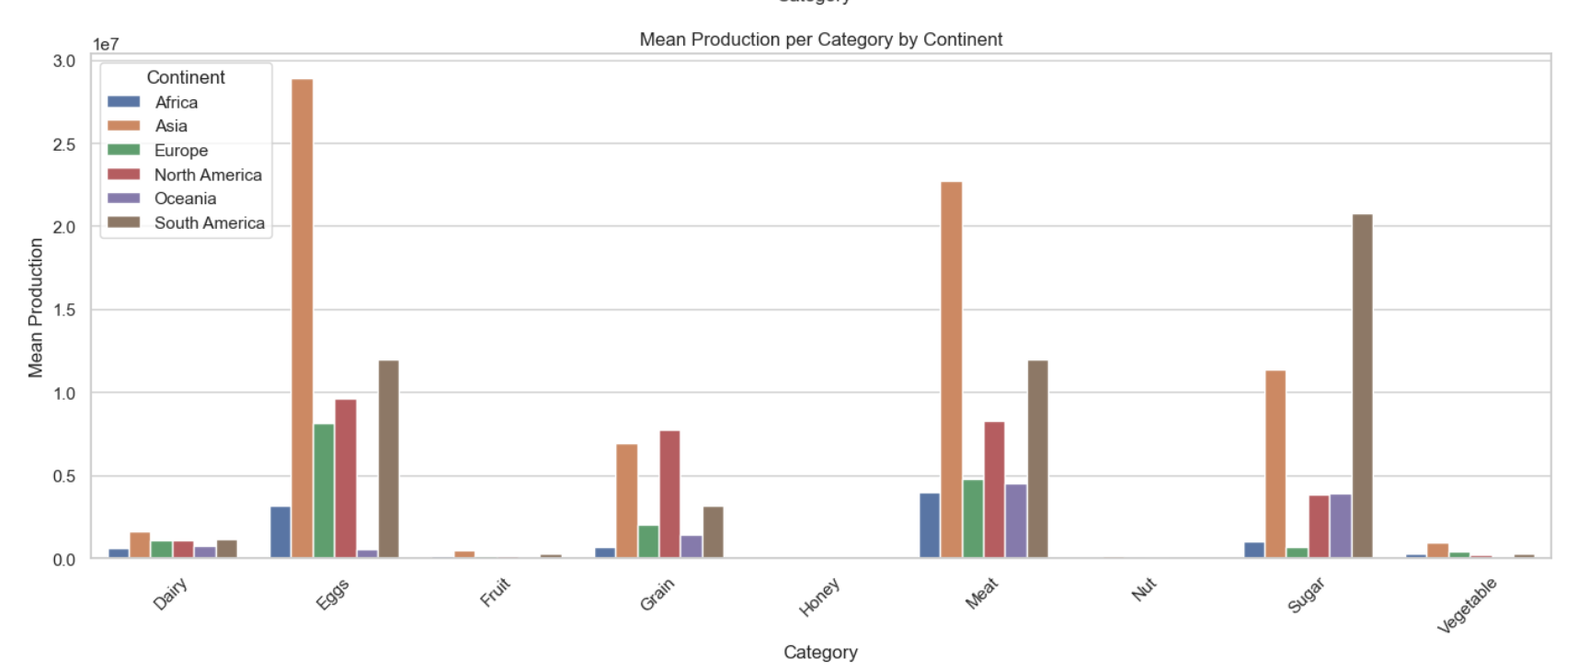
mean
sum

